Slide 1
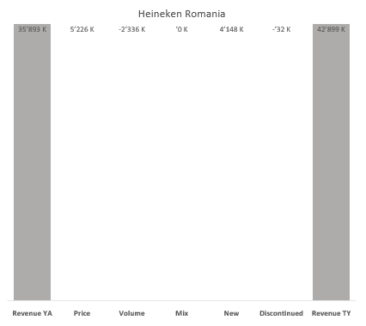
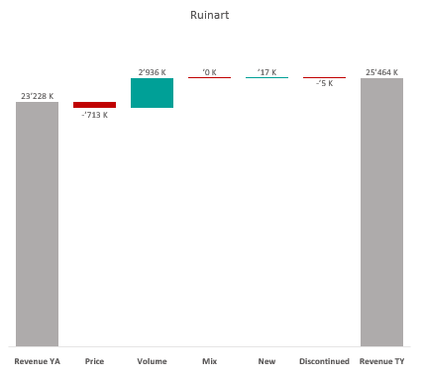
Revenue by Price vs. Volume vs. Mix analysis (Replace with So What)
Revenue by Price vs. Volume vs. Mix analysis | Nicolas vs. Ruinart | Champagnes | NATIONAL | P12M
DATA SOURCE: Trade Panel/Retailer Data | Ending June 2025

Slide 2
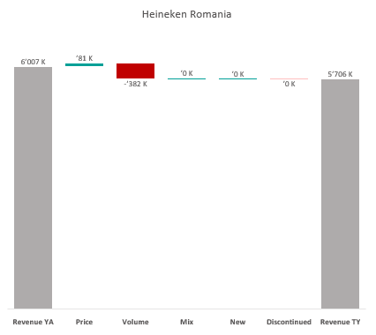
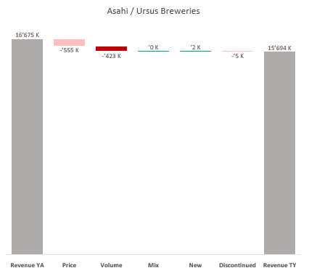
Revenue by Price vs. Volume vs. Mix analysis (Replace with So What)
Revenue by Price vs. Volume vs. Mix analysis | Nicolas vs. Ruinart | Champagnes | NICOLAS | P12M
DATA SOURCE: Trade Panel/Retailer Data | Ending June 2025

Slide 3
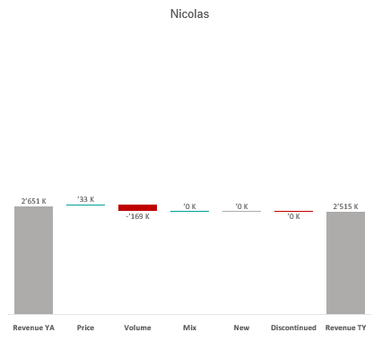
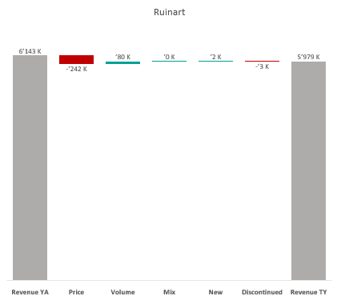
Revenue by Price vs. Volume vs. Mix analysis (Replace with So What)
Revenue by Price vs. Volume vs. Mix analysis | Nicolas vs. Ruinart | Champagnes | NICOLAS QCN | P12M
DATA SOURCE: Trade Panel/Retailer Data | Ending June 2025

Slide 4
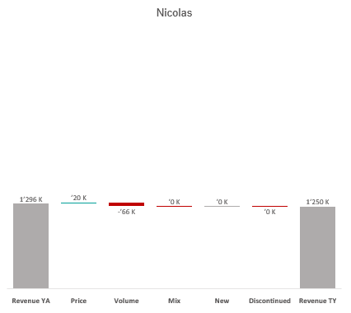
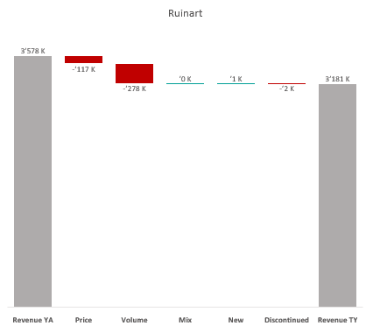
Revenue by Price vs. Volume vs. Mix analysis (Replace with So What)
Revenue by Price vs. Volume vs. Mix analysis | Nicolas vs. Ruinart | Champagnes | NICOLAS VCN | P12M
DATA SOURCE: Trade Panel/Retailer Data | Ending June 2025

Slide 5
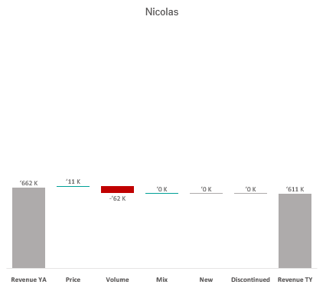
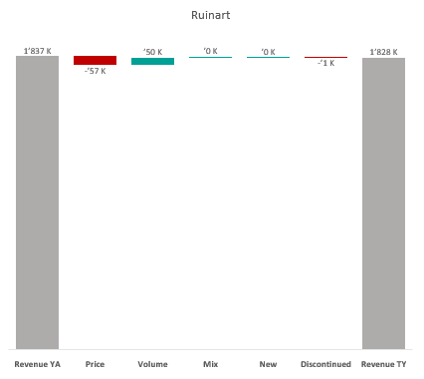
Revenue by Price vs. Volume vs. Mix analysis (Replace with So What)
Revenue by Price vs. Volume vs. Mix analysis | Nicolas vs. Ruinart | Champagnes | NICOLAS QCT | P12M
DATA SOURCE: Trade Panel/Retailer Data | Ending June 2025

Slide 6
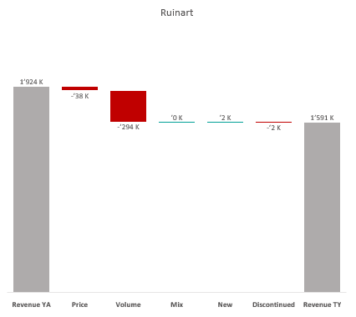
Revenue by Price vs. Volume vs. Mix analysis (Replace with So What)
Revenue by Price vs. Volume vs. Mix analysis | Nicolas vs. Ruinart | Champagnes | NICOLAS QCA | P12M
DATA SOURCE: Trade Panel/Retailer Data | Ending June 2025

Slide 7
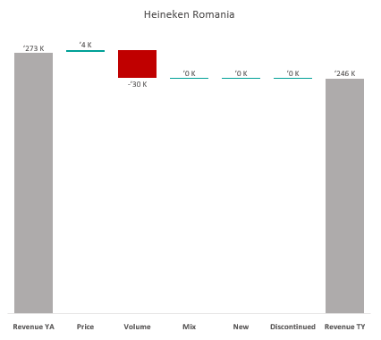
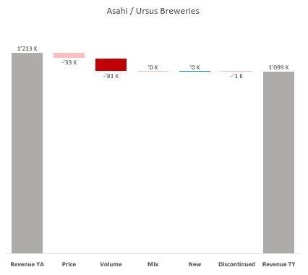
Revenue by Price vs. Volume vs. Mix analysis (Replace with So What)
Revenue by Price vs. Volume vs. Mix analysis | Nicolas vs. Ruinart | Champagnes | NICOLAS CCP | P12M
DATA SOURCE: Trade Panel/Retailer Data | Ending June 2025

Slide 8
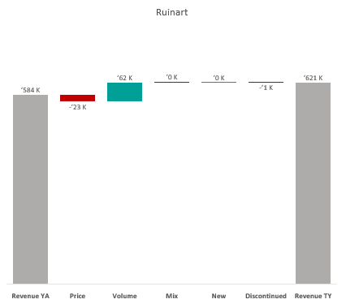
Revenue by Price vs. Volume vs. Mix analysis (Replace with So What)
Revenue by Price vs. Volume vs. Mix analysis | Nicolas vs. Ruinart | Champagnes | NICOLAS VCT | P12M
DATA SOURCE: Trade Panel/Retailer Data | Ending June 2025

Slide 9
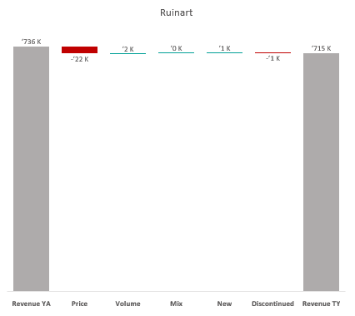
Revenue by Price vs. Volume vs. Mix analysis (Replace with So What)
Revenue by Price vs. Volume vs. Mix analysis | Nicolas vs. Ruinart | Champagnes | NICOLAS RN | P12M
DATA SOURCE: Trade Panel/Retailer Data | Ending June 2025

Slide 10
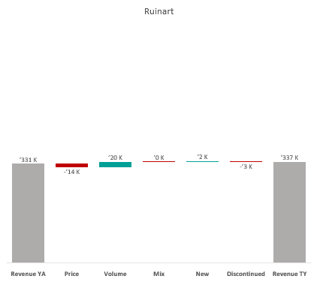
Revenue by Price vs. Volume vs. Mix analysis (Replace with So What)
Revenue by Price vs. Volume vs. Mix analysis | Nicolas vs. Ruinart | Champagnes | NICOLAS CCQ | P12M
DATA SOURCE: Trade Panel/Retailer Data | Ending June 2025

Slide 11
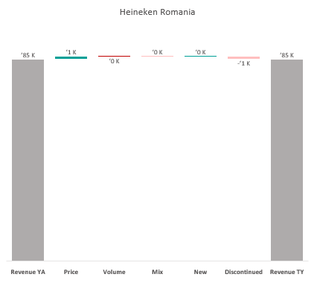
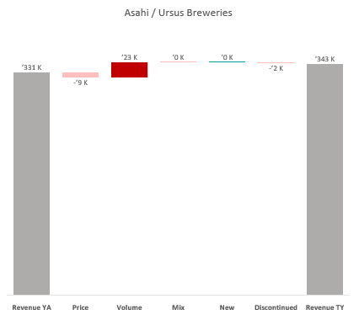
Revenue by Price vs. Volume vs. Mix analysis (Replace with So What)
Revenue by Price vs. Volume vs. Mix analysis | Nicolas vs. Ruinart | Champagnes | NICOLAS CCC | P12M
DATA SOURCE: Trade Panel/Retailer Data | Ending June 2025

Slide 12

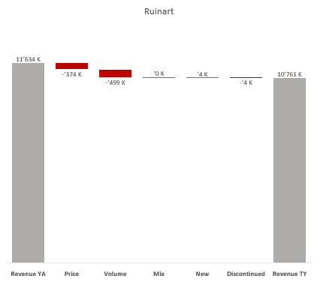
Revenue by Price vs. Volume vs. Mix analysis (Replace with So What)
Revenue by Price vs. Volume vs. Mix analysis | Nicolas vs. Ruinart | Champagnes | NICOLAS IDF | P12M
DATA SOURCE: Trade Panel/Retailer Data | Ending June 2025

Slide 13
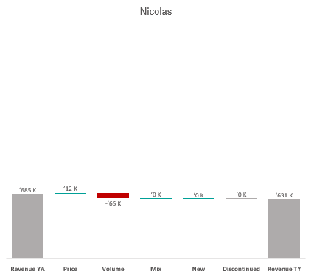
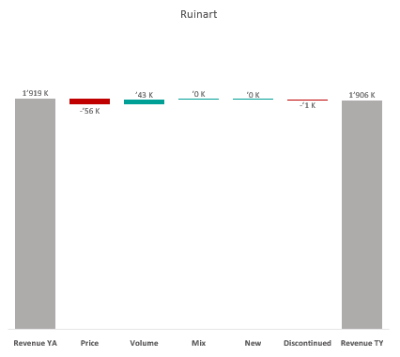
Revenue by Price vs. Volume vs. Mix analysis (Replace with So What)
Revenue by Price vs. Volume vs. Mix analysis | Nicolas vs. Ruinart | Champagnes | NICOLAS PAC | P12M
DATA SOURCE: Trade Panel/Retailer Data | Ending June 2025

Slide 14
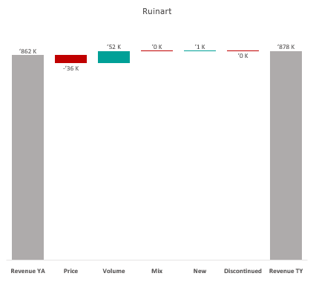
Revenue by Price vs. Volume vs. Mix analysis (Replace with So What)
Revenue by Price vs. Volume vs. Mix analysis | Nicolas vs. Ruinart | Champagnes | NICOLAS RHO | P12M
DATA SOURCE: Trade Panel/Retailer Data | Ending June 2025

Slide 15
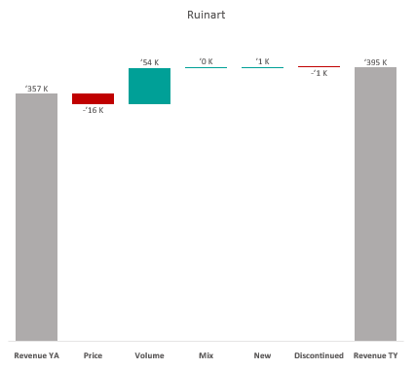
Revenue by Price vs. Volume vs. Mix analysis (Replace with So What)
Revenue by Price vs. Volume vs. Mix analysis | Nicolas vs. Ruinart | Champagnes | NICOLAS AQU | P12M
DATA SOURCE: Trade Panel/Retailer Data | Ending June 2025

Slide 16
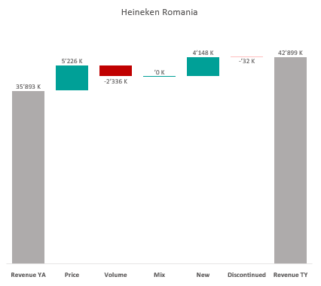

Revenue by Price vs. Volume vs. Mix analysis (Replace with So What)
Revenue by Price vs. Volume vs. Mix analysis | Nicolas vs. Ruinart | Champagnes | NICOLAS EST | P12M
DATA SOURCE: Trade Panel/Retailer Data | Ending June 2025

Slide 17

Revenue by Price vs. Volume vs. Mix analysis (Replace with So What)
Revenue by Price vs. Volume vs. Mix analysis | Heineken Romania vs. Asahi | Category | National | P12M
DATA SOURCE: Trade Panel/Retailer Data | Ending Apr 2024

Slide 18
Revenue by Price vs. Volume vs. Mix analysis (Replace with So What)
Revenue by Price vs. Volume vs. Mix analysis | Heineken Romania vs. Asahi | Category | National | P12M
DATA SOURCE: Trade Panel/Retailer Data | Ending Apr 2024

Slide 19
Revenue by Price vs. Volume vs. Mix analysis (Replace with So What)
Revenue by Price vs. Volume vs. Mix analysis | Heineken Romania vs. Asahi | Category | National | P12M
DATA SOURCE: Trade Panel/Retailer Data | Ending Apr 2024

Slide 20
Revenue by Price vs. Volume vs. Mix analysis (Replace with So What)
Revenue by Price vs. Volume vs. Mix analysis | Heineken Romania vs. Asahi | Category | National | P12M
DATA SOURCE: Trade Panel/Retailer Data | Ending Apr 2024

Slide 21
Revenue by Price vs. Volume vs. Mix analysis (Replace with So What)
Revenue by Price vs. Volume vs. Mix analysis | Heineken Romania vs. Asahi | Category | National | P12M
DATA SOURCE: Trade Panel/Retailer Data | Ending Apr 2024

Slide 22
Revenue by Price vs. Volume vs. Mix analysis (Replace with So What)
Revenue by Price vs. Volume vs. Mix analysis | Heineken Romania vs. Asahi | Category | National | P12M
DATA SOURCE: Trade Panel/Retailer Data | Ending Apr 2024

Slide 23
Revenue by Price vs. Volume vs. Mix analysis (Replace with So What)
Revenue by Price vs. Volume vs. Mix analysis | Heineken Romania vs. Asahi | Category | National | P12M
DATA SOURCE: Trade Panel/Retailer Data | Ending Apr 2024

Slide 24
Revenue by Price vs. Volume vs. Mix analysis (Replace with So What)
Revenue by Price vs. Volume vs. Mix analysis | Heineken Romania vs. Asahi | Category | National | P12M
DATA SOURCE: Trade Panel/Retailer Data | Ending Apr 2024

Slide 25
Revenue by Price vs. Volume vs. Mix analysis (Replace with So What)
Revenue by Price vs. Volume vs. Mix analysis | Heineken Romania vs. Asahi | Category | National | P12M
DATA SOURCE: Trade Panel/Retailer Data | Ending Apr 2024

Slide 26
Revenue by Price vs. Volume vs. Mix analysis (Replace with So What)
Revenue by Price vs. Volume vs. Mix analysis | Heineken Romania vs. Asahi | Category | National | P12M
DATA SOURCE: Trade Panel/Retailer Data | Ending Apr 2024

Slide 27
Revenue by Price vs. Volume vs. Mix analysis (Replace with So What)
Revenue by Price vs. Volume vs. Mix analysis | Heineken Romania vs. Asahi | Category | National | P12M
DATA SOURCE: Trade Panel/Retailer Data | Ending Apr 2024

Slide 28
Revenue by Price vs. Volume vs. Mix analysis (Replace with So What)
Revenue by Price vs. Volume vs. Mix analysis | Heineken Romania vs. Asahi | Category | National | P12M
DATA SOURCE: Trade Panel/Retailer Data | Ending Apr 2024

